Slide 1
JDBC

Slide 2
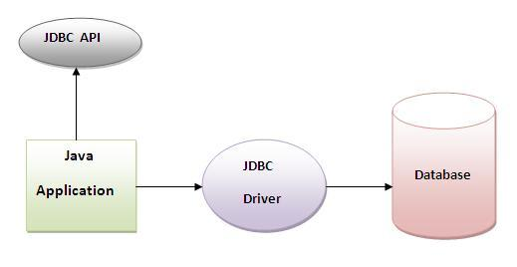
JDBC
Before JDBC, ODBC API was used to connect and execute query to the database. But ODBC API uses ODBC driver that is written in C language which is plateform dependent and unsecured. That is why Sun Microsystem has defined its own API (JDBC API) that uses JDBC driver written in Java language.
What is API?
API (Application programming interface) is a document that contains description of all the features of a product or software. It represents classes and interfaces that software programs can follow to communicate with each other. An API can be created for applications, libraries, operating systems, etc

Slide 3
JDBC
JDBC Driver
JDBC Driver is a software component that enables java application to interact with the database.There are 4 types of JDBC drivers:
JDBC-ODBC bridge driver
Native-API driver (partially java driver)
Network Protocol driver (fully java driver)
Thin driver (fully java driver)
JDBC-ODBC bridge driver
The JDBC-ODBC bridge driver uses ODBC driver to connect to the database. The JDBC-ODBC bridge driver converts JDBC method calls into the ODBC function calls. This is now discouraged because of thin driver.

Slide 4
JDBC
Native-API driver
The Native API driver uses the client-side libraries of the database. The driver converts JDBC method calls into native calls of the database API. It is not written entirely in java.
Network Protocol driver
The Network Protocol driver uses middleware (application server) that converts JDBC calls directly or indirectly into the vendor-specific database protocol. It is fully written in java.
Thin driver
The thin driver converts JDBC calls directly into the vendor-specific database protocol. That is why it is known as thin driver. It is fully written in Java language.

Slide 5
JDBC
5 Steps to connect to the database
Register the driver class
Creating connection
Creating statement
Executing queries
Closing connection
Register the driver class
The forName() method of Class class is used to register the driver class. This method is used to dynamically load the driver class.
Syntax of forName() method
public static void forName(String className)throws ClassNotFoundException
Example to register the mysql Driver class
Class.forName("com.mysql.jdbc.Driver");

Slide 6
JDBC
Create the connection object
The getConnection() method of DriverManager class is used to establish connection with the database.Syntax of getConnection() method
1) public static Connection getConnection(String url)throws SQLException
2) public static Connection getConnection(String url,String name,String password throws SQLException
Example to establish connection with the mysql database
Connection con=DriverManager.getConnection(
"jdbc:mysql://localhost:3306/myDatabase","root","root");
Create the Statement object
The createStatement() method of Connection interface is used to create statement. The object of statement is responsible to execute queries with the database.Syntax of createStatement() method
public Statement createStatement()throws SQLException
Example to create the statement object
Statement stmt=con.createStatement();

Slide 7
JDBC
Execute the query
The executeQuery() method of Statement interface is used to execute queries to the database. This method returns the object of ResultSet that can be used to get all the records of a table.Syntax of executeQuery() method
public ResultSet executeQuery(String sql)throws SQLException
Example to execute query
ResultSet rs=stmt.executeQuery("select * from emp");
while(rs.next()){
System.out.println(rs.getInt(1)+" "+rs.getString(2));
}

Slide 8
JDBC
Close the connection object
By closing connection object statement and ResultSet will be closed automatically. The close() method of Connection interface is used to close the connection.Syntax of close() method
public void close()throws SQLException
Example to close connection
con.close();

Slide 9
JDBC
DriverManager class
The DriverManager class acts as an interface between user and drivers. It keeps track of the drivers that are available and handles establishing a connection between a database and the appropriate driver. The DriverManager class maintains a list of Driver classes that have registered themselves by calling the method DriverManager.registerDriver().
Commonly used methods of DriverManager class:
1) public static void registerDriver(Driver driver): | is used to register the given driver with DriverManager.
2) public static void deregisterDriver(Driver driver): | is used to deregister the given driver (drop the driver from the list) with DriverManager.
3) public static Connection getConnection(String url): | is used to establish the connection with the specified url.
4) public static Connection getConnection(String url,String userName,String password): | is used to establish the connection with the specified url, username and password.

Slide 10
JDBC
Connection interface
A Connection is the session between java application and database. The Connection interface is a factory of Statement, PreparedStatement, and DatabaseMetaData i.e. object of Connection can be used to get the object of Statement and DatabaseMetaData. The Connection interface provide many methods for transaction management like commit(),rollback() etc.
By default, connection commits the changes after executing queries.
Commonly used methods of Connection interface:
public Statement createStatement(): creates a statement object that can be used to execute SQL queries.
public void setAutoCommit(boolean status): is used to set the commit status.By default it is true.
public void commit(): saves the changes made since the previous commit/rollback permanent.
public void rollback(): Drops all changes made since the previous commit/rollback.
public void close(): closes the connection and Releases a JDBC resources immediately.

Slide 11
JDBC
Statement interface
The Statement interface provides methods to execute queries with the database. The statement interface is a factory of ResultSet i.e. it provides factory method to get the object of ResultSet.
Commonly used methods of Statement interface:
1) public ResultSet executeQuery(String sql): is used to execute SELECT query. It returns the object of ResultSet.
2) public int executeUpdate(String sql): is used to execute specified query, it may be create, drop, insert, update, delete etc.
3) public int[] executeBatch(): is used to execute batch of commands.

Slide 12
JDBC
ResultSet interface
The object of ResultSet maintains a cursor pointing to a particular row of data. Initially, cursor points to before the first row.
By default, ResultSet object can be moved forward only and it is not updatable.
But we can make this object to move forward and backward direction by passing either TYPE_SCROLL_INSENSITIVE or TYPE_SCROLL_SENSITIVE in createStatement(int,int) method as well as we can make this object as updatable by:
Statement stmt = con.createStatement(ResultSet.TYPE_SCROLL_INSENSITIVE, ResultSet.CONCUR_UPDATABLE);

Slide 13
JDBC
1) public boolean next():is used to move the cursor to the one row next from the current position.
2) public boolean previous():is used to move the cursor to the one row previous from the current position.
3) public boolean first():is used to move the cursor to the first row in result set object.
4) public boolean last():is used to move the cursor to the last row in result set object.
5) public boolean absolute(int row):is used to move the cursor to the specified row number in the ResultSet object.
6) public int getInt(int columnIndex):is used to return the data of specified column index of the current row as int.
7) public int getInt(String columnName):is used to return the data of specified column name of the current row as int.
8) public String getString(int columnIndex):is used to return the data of specified column index of the current row as String
9) public String getString(String columnName):is used to return the data of specified column name of the current row as String.

Slide 14
JDBC
PreparedStatement interface
The PreparedStatement interface is a subinterface of Statement. It is used to execute parameterized query.
Let's see the example of parameterized query:
String sql="insert into emp values(?,?,?)";
As you can see, we are passing parameter (?) for the values. Its value will be set by calling the setter methods of PreparedStatement.
Why use PreparedStatement?
Improves performance: The performance of the application will be faster if you use PreparedStatement interface because query is compiled only once.
How to get the instance of PreparedStatement?
The prepareStatement() method of Connection interface is used to return the object of PreparedStatement. Syntax:
public PreparedStatement prepareStatement(String query)throws SQLException{}

Slide 15
JDBC
Methods of PreparedStatement interface
Method | Description
public void setInt(int paramIndex, int value) | sets the integer value to the given parameter index.
public void setString(int paramIndex, String value) | sets the String value to the given parameter index.
public void setFloat(int paramIndex, float value) | sets the float value to the given parameter index.
public void setDouble(int paramIndex, double value) | sets the double value to the given parameter index.
public int executeUpdate() | executes the query. It is used for create, drop, insert, update, delete etc.
public ResultSet executeQuery() | executes the select query. It returns an instance of ResultSet.

Slide 16
Remote Method Invocation (RMI)
The Remote Method Invocation (RMI) is an API that provides a mechanism to create distributed application in java. The RMI allows an object to invoke methods on an object running in another JVM.
The RMI provides remote communication between the applications using two objects stub and skeleton.
Understanding stub and skeleton
RMI uses stub and skeleton object for communication with the remote object.
A remote object is an object whose method can be invoked from another JVM. Let's understand the stub and skeleton objects:
Stub
The stub is an object, acts as a gateway for the client side. All the outgoing requests are routed through it. It resides at the client side and represents the remote object. When the caller invokes method on the stub object, it does the following tasks:
It initiates a connection with remote Virtual Machine (JVM),

Slide 17
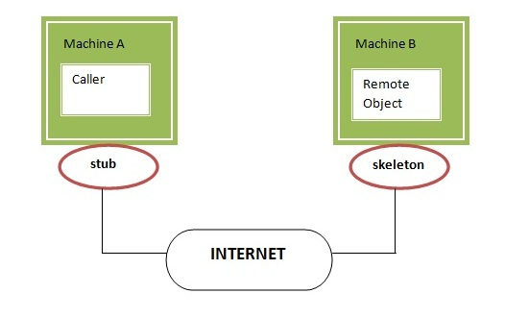
Remote Method Invocation (RMI)
It writes and transmits (marshals) the parameters to the remote Virtual Machine (JVM),
It waits for the result
It reads (unmarshals) the return value or exception, and
It finally, returns the value to the caller.

Slide 18
Remote Method Invocation (RMI)
skeleton
The skeleton is an object, acts as a gateway for the server side object. All the incoming requests are routed through it. When the skeleton receives the incoming request, it does the following tasks:
It reads the parameter for the remote method
It invokes the method on the actual remote object, and
It writes and transmits (marshals) the result to the caller.
In the Java 2 SDK, an stub protocol was introduced that eliminates the need for skeletons.
Understanding requirements for the distributed applications
If any application performs these tasks, it can be distributed application.
.The application need to locate the remote method
It need to provide the communication with the remote objects, and
The application need to load the class definitions for the objects.
The RMI application have all these features, so it is called the distributed application.

Slide 19
Remote Method Invocation (RMI)
Steps to write the RMI program
There is given the 6 steps to write the RMI program.
Create the remote interface
Provide the implementation of the remote interface
Compile the implementation class and create the stub and skeleton objects using the rmic tool
Start the registry service by rmiregistry tool
Create and start the remote application
Create and start the client application

Slide 20
Remote Method Invocation (RMI)
rmi services need to be hosted in a server process. The Naming class provides methods to get and store the remote object. The Naming class provides 5 methods.
public static java.rmi.Remote lookup(java.lang.String) throws java.rmi.NotBoundException, java.net.MalformedURLException, java.rmi.RemoteException; it returns the reference of the remote object.
public static void bind(java.lang.String, java.rmi.Remote) throws java.rmi.AlreadyBoundException, java.net.MalformedURLException, java.rmi.RemoteException; it binds the remote object with the given name.
public static void unbind(java.lang.String) throws java.rmi.RemoteException, java.rmi.NotBoundException, java.net.MalformedURLException; it destroys the remote object which is bound with the given name.
public static void rebind(java.lang.String, java.rmi.Remote) throws java.rmi.RemoteException, java.net.MalformedURLException; it binds the remote object to the new name.
public static java.lang.String[] list(java.lang.String) throws java.rmi.RemoteException, java.net.MalformedURLException; it returns an array of the names of the remote objects bound in the registry.

Slide 21
Servlet
Servlet technology is used to create web application (resides at server side and generates dynamic web page).
Servet technology is robust and scalable as it uses the java language. Before Servlet, CGI (Common Gateway Interface) scripting language was used as a server-side programming language. But there were many disadvantages of this technology
What is a Servlet?
Servlet can be described in many ways, depending on the context.
Servlet is a technology i.e. used to create web application.
Servlet is an API that provides many interfaces and classes including documentations.
Servlet is an interface that must be implemented for creating any servlet.
Servlet is a class that extend the capabilities of the servers and respond to the incoming request. It can respond to any type of requests.
Servlet is a web component that is deployed on the server to create dynamic w

Slide 22
Servlet
What is web application?
A web application is an application accessible from the web. A web application is composed of web components like Servlet, JSP, Filter etc. and other components such as HTML. The web components typically execute in Web Server and respond to HTTP request.
CGI(Commmon Gateway Interface)
CGI technology enables the web server to call an external program and pass HTTP request information to the external program to process the request. For each request, it starts a new process.
Disadvantages of CGI
If number of clients increases, it takes more time for sending response.
For each request, it starts a process and Web server is limited to start processes.
It uses platform dependent language e.g. C, C++, perl.

Slide 23
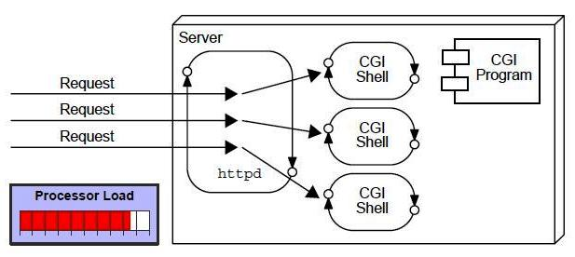
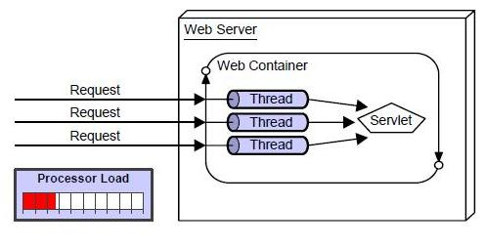
Servlet
Advantage of Servlet

Slide 24
Servlet
There are many advantages of Servlet over CGI. The web container creates threads for handling the multiple requests to the servlet. Threads have a lot of benefits over the Processes such as they share a common memory area, lighweight, cost of communication between the threads are low. The basic benefits of servlet are as follows:
better performance: because it creates a thread for each request not process.
Portability: because it uses java language.
Robust: Servlets are managed by JVM so no need to worry about momory leak, garbage collection etc.
Secure: because it uses java language..
Servlet Terminology
There are some key points that must be known by the servlet programmer like server, container, get request, post request etc.

Slide 25
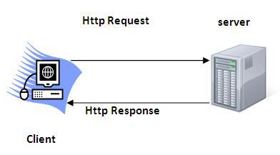
Servlet
HTTP (Hyper Text Transfer Protocol)
Http is the protocol that allows web servers and browsers to exchange data over the web.
It is a request response protocol.
Http uses reliable TCP connections bydefault on TCP port 80.
It is stateless means each request is considered as the new request. In other words, server doesn't recognize the user bydefault.

Slide 26
Servlet
Http Request Methods
Every request has a header that tells the status of the client. There are many request methods. Get and Post requests are mostly used.
HTTP Request | Description
GET | Asks to get the resource at the requested URL.
POST | Asks the server to accept the body info attached. It is like GET request with extra info sent with the request.
HEAD | Asks for only the header part of whatever a GET would return. Just like GET but with no body.
TRACE | Asks for the loopback of the request message, for testing or troubleshooting. TRACE allows the client to see what is being received at the other end of the request chain and use that data for testing or diagnostic information.d use that data for testing or diagnostic information.
PUT | Says to put the enclosed info (the body) at the requested URL.
DELETE | Says to delete the resource at the requested URL.
OPTIONS | Asks for a list of the HTTP methods to which the thing at the request URL can respond

Slide 27
Servlet
What is the difference between Get and Post?
GET | POST
1) In case of Get request, only limited amount of data can be sent because data is sent in header. | In case of post request, large amount of data can be sent because data is sent in body.
2) Get request is not secured because data is exposed in URL bar. | Post request is secured because data is not exposed in URL bar.
3) Get request can be bookmarked | Post request cannot be bookmarked
4) Get request is idempotent. It means second request will be ignored until response of first request is delivered. | Post request is non-idempotent
5) Get request is more efficient and used more than Post | Post request is less efficient and used less than get.

Slide 28
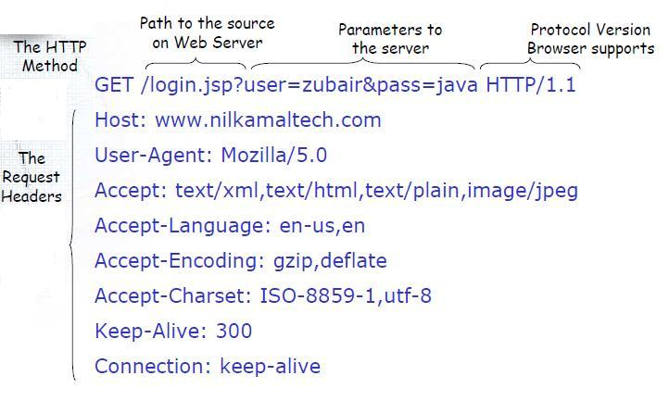
Servlet
Anatomy of Get Request
As we know that data is sent in request header in case of get request. It is the default request type.

Slide 29
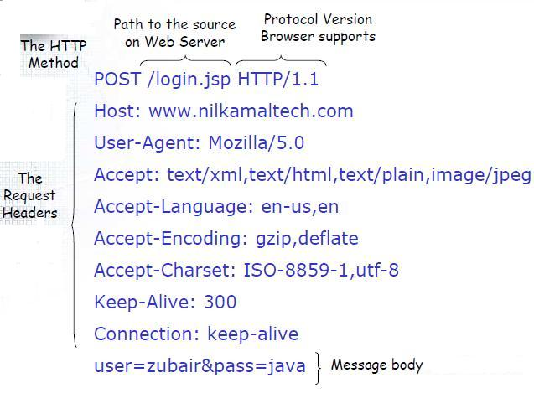
Servlet
Anatomy of Post Request
As we know, in case of post request original data is sent in message body.

Slide 30
Servlet
Container
It provides runtime environment for JavaEE (j2ee) applications.
It performs many operations that are given below:
Life Cycle Management
Multithreaded support
Object Pooling
Security etc.
Server
It is a running program or software that provides services.
There are two types of servers:
Web Server
Application Server

Slide 31
Servlet
Web Server
Web server contains only web or servlet container. It can be used for servlet, jsp, struts, jsf etc. It can't be used for EJB.
Example of Web Servers are: Apache Tomcat and Resin.
Application Server
Application server contains Web and EJB containers. It can be used for servlet, jsp, struts, jsf, ejb etc.
Example of Application Servers are:
JBoss Open-source server from JBoss community.
Glassfish provided by Sun Microsystem. Now acquired by Oracle.
Weblogic provided by Oracle. It more secured.
Websphere provided by IBM.

Slide 32
Servlet
Content Type
Content Type is also known as MIME (Multipurpose internet Mail Extension) Type. It is a HTTP header that provides the description about what are you sending to the browser.
Eg text/html , application/pdf
Servlet API
The javax.servlet and javax.servlet.http packages represent interfaces and classes for servlet api.
The javax.servlet package contains many interfaces and classes that are used by the servlet or web container. These are not specific to any protocol.
The javax.servlet.http package contains interfaces and classes that are responsible for http requests only.

Slide 33
Servlet
Interfaces in javax.servlet package
Servlet
ServletRequest
ServletResponse
RequestDispatcher
ServletConfig
ServletContext
Filter
FilterConfig
FilterChain
Classes in javax.servlet package
GenericServlet
ServletInputStream
ServletOutputStream

Slide 34
Servlet
Interfaces in javax.servlet.http package
HttpServletRequest
HttpServletResponse
HttpSession
Classes in javax.servlet.http package
HttpServlet
Cookie
Servlet Interface
Servlet interface provides common behaviour to all the servlets.
Servlet interface needs to be implemented for creating any servlet (either directly or indirectly). It provides 3 life cycle methods that are used to initialize the servlet, to service the requests, and to destroy the servlet and 2 non-life cycle methods

Slide 35
Servlet
Servlet interface provides common behaviour to all the servlets.
Servlet interface needs to be implemented for creating any servlet (either directly or indirectly). It provides 3 life cycle methods that are used to initialize the servlet, to service the requests, and to destroy the servlet and 2 non-life cycle methods
Methods of Servlet interface
There are 5 methods in Servlet interface. The init, service and destroy are the life cycle methods of servlet. These are invoked by the web container.
Method | Description
public void init(ServletConfig config) | initializes the servlet. It is the life cycle method of servlet and invoked by the web container only once.
public void service(ServletRequest request,ServletResponse response) | provides response for the incoming request. It is invoked at each request by the web container.
public void destroy() | is invoked only once and indicates that servlet is being destroyed.
public ServletConfig getServletConfig() | returns the object of ServletConfig.
public String getServletInfo() | returns information about servlet such as writer, copyright, version etc.

Slide 36
Servlet
GenericServlet class
GenericServlet class implements Servlet,ServletConfig and Serializable interfaces. It provides the implementaion of all the methods of these interfaces except the service method.
GenericServlet class can handle any type of request so it is protocol-independent.
You may create a generic servlet by inheriting the GenericServlet class and providing the implementation of the service method.
Methods of GenericServlet class
public void init(ServletConfig config) is used to initialize the servlet.
public abstract void service(ServletRequest request, ServletResponse response) provides service for the incoming request. It is invoked at each time when user requests for a servlet.
public void destroy() is invoked only once throughout the life cycle and indicates that servlet is being destroyed.
public ServletConfig getServletConfig() returns the object of ServletConfig.
public String getServletInfo() returns information about servlet such as writer, copyright, version etc.

Slide 37
Servlet
public ServletContext getServletContext() returns the object of ServletContext.
public String getInitParameter(String name) returns the parameter value for the given parameter name.
public Enumeration getInitParameterNames() returns all the parameters defined in the web.xml file.
public String getServletName() returns the name of the servlet object.
HttpServlet class
The HttpServlet class extends the GenericServlet class . It provides http specific methods such as doGet, doPost etc.
Methods of HttpServlet class

Slide 38
Servlet
public void service(ServletRequest req,ServletResponse res) dispatches the request to the protected service method by converting the request and response object into http type.
protected void service(HttpServletRequest req, HttpServletResponse res) receives the request from the service method, and dispatches the request to the doXXX() method depending on the incoming http request type.
protected void doGet(HttpServletRequest req, HttpServletResponse res) handles the GET request. It is invoked by the web container.
protected void doPost(HttpServletRequest req, HttpServletResponse res) handles the POST request. It is invoked by the web container.
protected void doHead(HttpServletRequest req, HttpServletResponse res) handles the HEAD request. It is invoked by the web container.
protected void doOptions(HttpServletRequest req, HttpServletResponse res) handles the OPTIONS request. It is invoked by the web container.
protected void doPut(HttpServletRequest req, HttpServletResponse res) handles the PUT request. It is invoked by the web container.
protected void doTrace(HttpServletRequest req, HttpServletResponse res) handles the TRACE request. It is invoked by the web container.
protected void doDelete(HttpServletRequest req, HttpServletResponse res) handles the DELETE request. It is invoked by the web container.

Slide 39
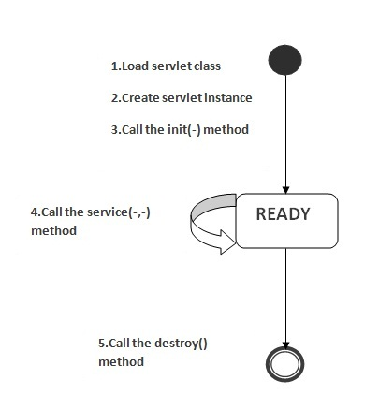
Servlet
Life Cycle of a Servlet
The web container maintains the life cycle of a servlet instance. Let's see the life cycle of the servlet:
Servlet class is loaded.
Servlet instance is created.
init method is invoked.
service method is invoked.
destroy method is invoked.

Slide 40
Servlet
there are three states of a servlet: new, ready and end. The servlet is in new state if servlet instance is created. After invoking the init() method, Servlet comes in the ready state. In the ready state, servlet performs all the tasks. When the web container invokes the destroy() method, it shifts to the end state.
1) Servlet class is loaded
The classloader is responsible to load the servlet class. The servlet class is loaded when the first request for the servlet is received by the web container.
2) Servlet instance is created
The web container creates the instance of a servlet after loading the servlet class. The servlet instance is created only once in the servlet life cycle.
3) init method is invoked
The web container calls the init method only once after creating the servlet instance. The init method is used to initialize the servlet. It is the life cycle method of the javax.servlet.Servlet interface. Syntax of the init method is given below:
public void init(ServletConfig config) throws ServletException

Slide 41
Servlet
4) service method is invoked
The web container calls the service method each time when request for the servlet is received. If servlet is not initialized, it follows the first three steps as described above then calls the service method. If servlet is initialized, it calls the service method. Notice that servlet is initialized only once. The syntax of the service method of the Servlet interface is given below:
public void service(ServletRequest request, ServletResponse response)
throws ServletException, IOException
5) destroy method is invoked
The web container calls the destroy method before removing the servlet instance from the service. It gives the servlet an opportunity to clean up any resource for example memory, thread etc. The syntax of the destroy method of the Servlet interface is given below:
public void destroy()

Slide 42
Servlet
Steps to create a servlet
The servlet example can be created by three ways:
By implementing Servlet interface,
By inheriting GenericServlet class, (or)
By inheriting HttpServlet class
1)Create a directory structures
The directory structure defines that where to put the different types of files so that web container may get the information and respond to the client.
2)Create a Servlet
There are three ways to create the servlet.By implementing the Servlet interface
By inheriting the GenericServlet class
By inheriting the HttpServlet class
3)Compile the servlet
For compiling the Servlet, jar file is required to be loaded. Different Servers provide different jar files
servlet-api.jar Apache Tomacat

Slide 43
Servlet
4)Create the deployment descriptor (web.xml file)
The deployment descriptor is an xml file, from which Web Container gets the information about the servet to be invoked.
<web-app> represents the whole application.
<servlet> is sub element of <web-app> and represents the servlet.
<servlet-name> is sub element of <servlet> represents the name of the servlet.
<servlet-class> is sub element of <servlet> represents the class of the servlet.
<servlet-mapping> is sub element of <web-app>. It is used to map the servlet.
<url-pattern> is sub element of <servlet-mapping>. This pattern is used at client side to invoke the servlet.

Slide 44
Servlet
How Servlet works?
The server checks if the servlet is requested for the first time.
If yes, web container does the following tasks:
loads the servlet class.
instantiates the servlet class.
calls the init method passing the ServletConfig object
else
calls the service method passing request and response objects
The web container calls the destroy method when it needs to remove the servlet such as at time of stopping server or undeploying the project.

Slide 45
Servlet
How web container handles the servlet request?
The web container is responsible to handle the request. Let's see how it handles the request.
maps the request with the servlet in the web.xml file.
creates request and response objects for this request
calls the service method on the thread
The public service method internally calls the protected service method
The protected service method calls the doGet method depending on the type of request.
The doGet method generates the response and it is passed to the client.
After sending the response, the web container deletes the request and response objects. The thread is contained in the thread pool or deleted depends on the server implementation.

Slide 46
Servlet
What is written inside the public service method?
The public service method converts the ServletRequest object into the HttpServletRequest type and ServletResponse object into the HttpServletResponse type. Then, calls the service method passing these objects. Let's see the internal code:
public void service(ServletRequest req, ServletResponse res)
throws ServletException, IOException
{
HttpServletRequest request;
HttpServletResponse response;
try
{
request = (HttpServletRequest)req;
response = (HttpServletResponse)res;
}
catch(ClassCastException e)
{
throw new ServletException("non-HTTP request or response");
}
service(request, response);
}

Slide 47
Servlet
What is written inside the protected service method?
The protected service method checks the type of request, if request type is get, it calls doGet method, if request type is post, it calls doPost method, so on. Let's see the internal code:
protected void service(HttpServletRequest req, HttpServletResponse resp)
throws ServletException, IOException
{
String method = req.getMethod();
if(method.equals("GET"))
{
long lastModified = getLastModified(req);
if(lastModified == -1L)
{
doGet(req, resp);
}
....
//rest of the code
}
}

Slide 48
Servlet
War File
A war (web archive) File contains files of a web project. It may have servlet, xml, jsp, image, html, css, js etc. files.
What is war file?
web archive (war) file contains all the contents of a web application. It reduces the time duration for transferring file.
Advantage of war file
saves time: The war file combines all the files into a single unit. So it takes less time while transferring file from client to server.
welcome-file-list in web.xml
The welcome-file-list element of web-app, is used to define a list of welcome files. Its sub element iswelcome-file that is used to define the welcome file.
A welcome file is the file that is invoked automatically by the server, if you don't specify any file name.

Slide 49
Servlet
By default server looks for the welcome file in following order:
index.html
index.htm
index.jsp
If none of these files are found, server renders 404 error.
load on startup in web.xml
The load-on-startup element of web-app loads the servlet at the time of deployment or server start if value is positive. It is also known as pre initialization of servlet.
You can pass positive and negative value for the servlet.
Advantage of load-on-startup element
As you know well, servlet is loaded at first request. That means it consumes more time at first request. If you specify the load-on-startup in web.xml, servlet will be loaded at project deployment time or server start. So, it will take less time for responding to first request.

Slide 50
Servlet
Passing positive value
If you pass the positive value, the lower integer value servlet will be loaded before the higher integer value servlet. In other words, container loads the servlets in ascending integer value. The 0 value will be loaded first then 1, 2, 3 and so on.
<web-app>
....
<servlet>
<servlet-name>servlet1</servlet-name>
<servlet-class>pack1.FirstServlet</servlet-class>
<load-on-startup>0</load-on-startup>
</servlet>
<servlet>
<servlet-name>servlet2</servlet-name>
<servlet-class>pack1.SecondServlet</servlet-class>
<load-on-startup>1</load-on-startup>
</servlet>
...
</web-app>

Slide 51
Servlet
There are defined 2 servlets, both servlets will be loaded at the time of project deployment or server start. But, servlet1 will be loaded first then servlet2.
Passing negative value
If you pass the negative value, servlet will be loaded at request time, at first request.
ServletRequest Interface
An object of ServletRequest is used to provide the client request information to a servlet such as content type, content length, parameter names and values, header informations, attributes etc.
Methods of ServletRequest interface
Method | Description
public String getParameter(String name) | is used to obtain the value of a parameter by name.
public String[] getParameterValues(String name) | returns an array of String containing all values of given parameter name. It is mainly used to obtain values of a Multi select list box.
java.util.Enumeration getParameterNames() | returns an enumeration of all of the request parameter names.

Slide 52
Servlet
public String getCharacterEncoding() | Returns the character set encoding for the input of this request.
public String getContentType() | Returns the Internet Media Type of the request entity data, or null if not known.
public ServletInputStream getInputStream() throws IOException | Returns an input stream for reading binary data in the request body.
public abstract String getServerName() | Returns the host name of the server that received the request.
public int getServerPort() | Returns the port number on which this request was received.

Slide 53
Servlet
RequestDispatcher in Servlet
The RequestDispacher interface provides the facility of dispatching the request to another resource it may be html, servlet or jsp.This interface can also be used to include the content of antoher resource also. It is one of the way of servlet collaboration.
Methods of RequestDispatcher interface
public void forward(ServletRequest request,ServletResponse response)throws ServletException,java.io.IOException:Forwards a request from a servlet to another resource (servlet, JSP file, or HTML file) on the server.
public void include(ServletRequest request,ServletResponse response)throws ServletException,java.io.IOException:Includes the content of a resource (servlet, JSP page, or HTML file) in the response.

Slide 54
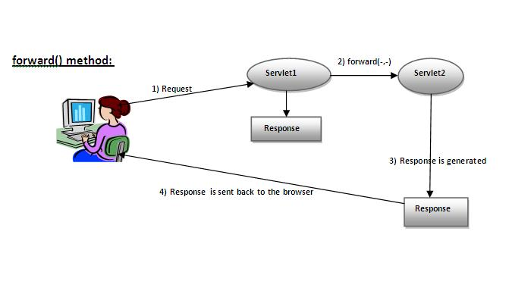
Servlet
As you see in the above figure, response of second servlet is sent to the client. Response of the first servlet is not displayed to the user.

Slide 55
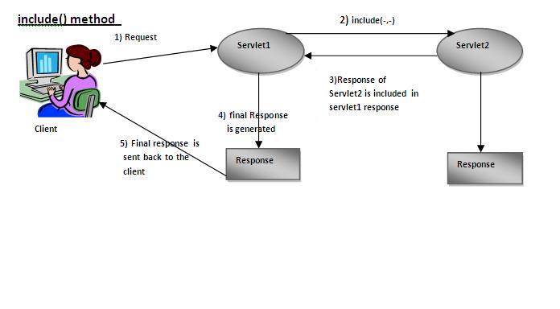
Servlet
As you can see in the above figure, response of second servlet is included in the response of the first servlet that is being sent to the client.

Slide 56
Servlet
How to get the object of RequestDispatcher
The getRequestDispatcher() method of ServletRequest interface returns the object of RequestDispatcher. Syntax:
Syntax of getRequestDispatcher method
public RequestDispatcher getRequestDispatcher(String resource);
Example of using getRequestDispatcher method
RequestDispatcher rd=request.getRequestDispatcher("servlet2");
//servlet2 is the url-pattern of the second servlet

Slide 57
Servlet
SendRedirect in servlet
The sendRedirect() method ofHttpServletResponse interface can be used to redirect response to another resource, it may be servlet, jsp or html file.
It accepts relative as well as absolute URL.
It works at client side because it uses the url bar of the browser to make another request. So, it can work inside and outside the server
Difference between forward() and sendRedirect() method
forward() method | sendRedirect() method
The forward() method works at server side. | The sendRedirect() method works at client side.
It sends the same request and response objects to another servlet. | It always sends a new request.
It can work within the server only. | It can be used within and outside the server.
Example: request.getRequestDispacher("servlet2").forward(request,response); | Example: response.sendRedirect("servlet2");

Slide 58
Servlet
Syntax of sendRedirect() method
public void sendRedirect(String URL)throws IOException;
ServletConfig Interface
An object of ServletConfig is created by the web container for each servlet. This object can be used to get configuration information from web.xml file.
If the configuration information is modified from the web.xml file, we don't need to change the servlet. So it is easier to manage the web application if any specific content is modified from time to time.
Advantage of ServletConfig
The core advantage of ServletConfig is that you don't need to edit the servlet file if information is modified from the web.xml file.
Methods of ServletConfig interface
public String getInitParameter(String name):Returns the parameter value for the specified parameter name.
public Enumeration getInitParameterNames():Returns an enumeration of all the initialization parameter names.
public String getServletName():Returns the name of the servlet.
public ServletContext getServletContext():Returns an object of ServletContext.

Slide 59
Servlet
How to get the object of ServletConfig
getServletConfig() method of Servlet interface returns the object of ServletConfig.
Syntax of getServletConfig() method
public ServletConfig getServletConfig();
ServletContext Interface
An object of ServletContext is created by the web container at time of deploying the project. This object can be used to get configuration information from web.xml file. There is only one ServletContext object per web application.
If any information is shared to many servlet, it is better to provide it from the web.xml file using the<context-param> element.
Advantage of ServletContext
Easy to maintain if any information is shared to all the servlet, it is better to make it available for all the servlet. We provide this information from the web.xml file, so if the information is changed, we don't need to modify the servlet. Thus it removes maintenance problem.

Slide 60
Servlet
Commonly used methods of ServletContext interface
public String getInitParameter(String name):Returns the parameter value for the specified parameter name.
public Enumeration getInitParameterNames():Returns the names of the context's initialization parameters.
public void setAttribute(String name,Object object):sets the given object in the application scope.
public Object getAttribute(String name):Returns the attribute for the specified name.
public Enumeration getInitParameterNames():Returns the names of the context's initialization parameters as an Enumeration of String objects.
public void removeAttribute(String name):Removes the attribute with the given name from the servlet context.
How to get the object of ServletContext interface
getServletContext() method of ServletConfig interface returns the object of ServletContext.
getServletContext() method of GenericServlet class returns the object of ServletContext.

Slide 61
Servlet
Syntax of getServletContext() method
public ServletContext getServletContext()
Attribute in Servlet
An attribute in servlet is an object that can be set, get or removed from one of the following scopes:
request scope
session scope
application scope
The servlet programmer can pass informations from one servlet to another using attributes. It is just like passing object from one class to another so that we can reuse the same object again and again
Attribute specific methods of ServletRequest, HttpSession and ServletContext interface
public void setAttribute(String name,Object object):sets the given object in the application scope.
public Object getAttribute(String name):Returns the attribute for the specified name.
public Enumeration getInitParameterNames():Returns the names of the context's initialization parameters as an Enumeration of String objects.
public void removeAttribute(String name):Removes the attribute with the given name from the servlet context.

Slide 62
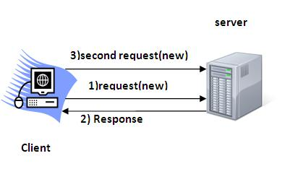
Servlet
Difference between ServletConfig and ServletContext
The servletconfig object refers to the single servlet whereas servletcontext object refers to the whole web application.
Session Tracking in Servlets
Session simply means a particular interval of time.
Session Tracking is a way to maintain state (data) of an user. It is also known as session managementin servlet.
Http protocol is a stateless so we need to maintain state using session tracking techniques. Each time user requests to the server, server treats the request as the new request. So we need to maintain the state of an user to recognize to particular user.
HTTP is stateless that means each request is considered as the new request. It is shown in the figure given below:

Slide 63
Servlet
Why use Session Tracking?
To recognize the user It is used to recognize the particular user.
Session Tracking Techniques
Cookies
Hidden Form Field
URL Rewriting
HttpSession
Cookies in Servlet
A cookie is a small piece of information that is persisted between the multiple client requests.
A cookie has a name, a single value, and optional attributes such as a comment, path and domain qualifiers, a maximum age, and a version number.
How Cookie works

Slide 64
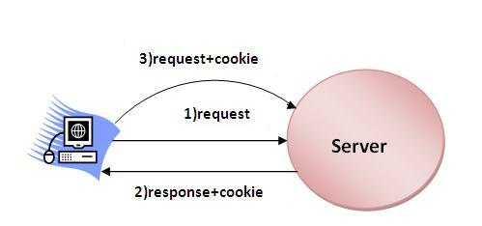
Servlet
By default, each request is considered as a new request. In cookies technique, we add cookie with response from the servlet. So cookie is stored in the cache of the browser. After that if request is sent by the user, cookie is added with request by default. Thus, we recognize the user as the old user.
Types of Cookie
Non-persistent cookie
Persistent cookie

Slide 65
Servlet
Non-persistent cookie
It is valid for single session only. It is removed each time when user closes the browser.
Persistent cookie
It is valid for multiple session . It is not removed each time when user closes the browser. It is removed only if user logout or sign out.
Advantage of Cookies
Simplest technique of maintaining the state.
Cookies are maintained at client side.
Disadvantage of Cookies
It will not work if cookie is disabled from the browser.
Only textual information can be set in Cookie object.
Cookie class
javax.servlet.http.Cookie class provides the functionality of using cookies. It provides a lot of useful methods for cookies.

Slide 66
Servlet
Constructor of Cookie class
Useful Methods of Cookie class
Constructor | Description
Cookie() | constructs a cookie.
Cookie(String name, String value) | constructs a cookie with a specified name and value.
Method | Description
public void setMaxAge(int expiry) | Sets the maximum age of the cookie in seconds.
public String getName() | Returns the name of the cookie. The name cannot be changed after creation.
public String getValue() | Returns the value of the cookie.
public void setName(String name) | changes the name of the cookie.
public void setValue(String value) | changes the value of the cookie.

Slide 67
Servlet
Other methods required for using Cookies
For adding cookie or getting the value from the cookie, we need some methods provided by other interfaces. They are:
public void addCookie(Cookie ck):method of HttpServletResponse interface is used to add cookie in response object.
public Cookie[] getCookies():method of HttpServletRequest interface is used to return all the cookies from the browser.
How to delete Cookie?
Cookie ck=new Cookie("user","");//deleting value of cookie
ck.setMaxAge(0);//changing the maximum age to 0 seconds
response.addCookie(ck);//adding cookie in the response

Slide 68
Servlet
Hidden Form Field
In case of Hidden Form Field a hidden (invisible) textfield is used for maintaining the state of an user.
In such case, we store the information in the hidden field and get it from another servlet. This approach is better if we have to submit form in all the pages and we don't want to depend on the browser.
Let's see the code to store value in hidden field.
<input type="hidden" name="uname" value=“satya rai">
Here, uname is the hidden field name and satya rai is the hidden field value.
Advantage of Hidden Form Field
It will always work whether cookie is disabled or not.
Disadvantage of Hidden Form Field:
It is maintained at server side.
Extra form submission is required on each pages.
Only textual information can be used.

Slide 69
Servlet
URL Rewriting
In URL rewriting, we append a token or identifier to the URL of the next Servlet or the next resource. We can send parameter name/value pairs using the following format:
url?name1=value1&name2=value2&??
A name and a value is separated using an equal = sign, a parameter name/value pair is separated from another parameter using the ampersand(&). When the user clicks the hyperlink, the parameter name/value pairs will be passed to the server. From a Servlet, we can use getParameter() method to obtain a parameter value.
Advantage of URL Rewriting
It will always work whether cookie is disabled or not (browser independent).
Extra form submission is not required on each pages.
Disadvantage of URL Rewriting
It will work only with links.
It can send Only textual information.

Slide 70
Servlet
HttpSession interface
In such case, container creates a session id for each user.The container uses this id to identify the particular user.An object of HttpSession can be used to perform two tasks:
bind objects
view and manipulate information about a session, such as the session identifier, creation time, and last accessed time.
How to get the HttpSession object ?
The HttpServletRequest interface provides two methods to get the object of HttpSession:
public HttpSession getSession():Returns the current session associated with this request, or if the request does not have a session, creates one.
public HttpSession getSession(boolean create):Returns the current HttpSession associated with this request or, if there is no current session and create is true, returns a new session.

Slide 71
Servlet
Commonly used methods of HttpSession interface
public String getId():Returns a string containing the unique identifier value.
public long getCreationTime():Returns the time when this session was created, measured in milliseconds since midnight January 1, 1970 GMT.
public long getLastAccessedTime():Returns the last time the client sent a request associated with this session, as the number of milliseconds since midnight January 1, 1970 GMT.
public void invalidate():Invalidates this session then unbinds any objects bound to it.

Slide 72
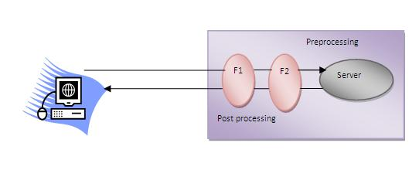
Servlet Filter
A filter is an object that is invoked at the preprocessing and postprocessing of a request.
It is mainly used to perform filtering tasks such as conversion, logging,input validation etc.
The servlet filter is pluggable, i.e. its entry is defined in the web.xml file, if we remove the entry of filter from the web.xml file, filter will be removed automatically and we don't need to change the servlet.
So maintenance cost will be less.

Slide 73
Servlet Filter
Advantage of Filter
Filter is pluggable.
One filter don't have dependency onto another resource.
Less Maintenance
Filter API
Like servlet filter have its own API. The javax.servlet package contains the three interfaces of Filter API.
Filter
FilterChain
FilterConfig
Filter interface
For creating any filter, you must implement the Filter interface. Filter interface provides the life cycle methods for a filter.

Slide 74
Servlet Filter
FilterChain interface
The object of FilterChain is responsible to invoke the next filter or resource in the chain.This object is passed in the doFilter method of Filter interface.The FilterChain interface contains only one method:
public void doFilter(HttpServletRequest request, HttpServletResponse response): it passes the control to the next filter or resource.
Method | Description
public void init(FilterConfig config) | init() method is invoked only once. It is used to initialize the filter.
public void doFilter(HttpServletRequest request,HttpServletResponse response, FilterChain chain) | doFilter() method is invoked every time when user request to any resource, to which the filter is mapped.It is used to perform filtering tasks.
public void destroy() | This is invoked only once when filter is taken out of the service.

Slide 75
Servlet Filter
How to define Filter
<web-app>
<filter>
<filter-name>...</filter-name>
<filter-class>...</filter-class>
</filter>
<filter-mapping>
<filter-name>...</filter-name>
<url-pattern>...</url-pattern>
</filter-mapping>
</web-app>

Slide 76
Servlet Filter
For mapping filter we can use, either url-pattern or servlet-name. The url-pattern elements has an advantage over servlet-name element i.e. it can be applied on servlet, JSP or HTML.
FilterConfig
An object of FilterConfig is created by the web container. This object can be used to get the configuration information from the web.xml file.
Methods of FilterConfig interface
There are following 4 methods in the FilterConfig interface.
public void init(FilterConfig config): init() method is invoked only once it is used to initialize the filter.
public String getInitParameter(String parameterName): Returns the parameter value for the specified parameter name.
public java.util.Enumeration getInitParameterNames(): Returns an enumeration containing all the parameter names.
public ServletContext getServletContext(): Returns the ServletContext object.

Slide 77
JSP
JSP technology is used to create web application just like Servlet technology. It can be thought of as an extension to servlet because it provides more functionality than servlet such as expression language, jstl etc.
A JSP page consists of HTML tags and JSP tags. The jsp pages are easier to maintain than servlet because we can separate designing and development. It provides some additional features such as Expression Language, Custom Tag etc.
Advantage of JSP over Servlet
There are many advantages of JSP over servlet. They are as follows:
1) Extension to Servlet
JSP technology is the extension to servlet technology. We can use all the features of servlet in JSP. In addition to, we can use implicit objects, predefined tags, expression language and Custom tags in JSP, that makes JSP development easy.
2) Easy to maintain
JSP can be easily managed because we can easily separate our business logic with presentation logic. In servlet technology, we mix our business logic with the presentation logic.
3) Fast Development: No need to recompile and redeploy
If JSP page is modified, we don't need to recompile and redeploy the project. The servlet code needs to be updated and recompiled if we have to change the look and feel of the application.
4) Less code than Servlet
In JSP, we can use a lot of tags such as action tags, jstl, custom tags etc. that reduces the code. Moreover, we can use EL, implicit objects etc.

Slide 78
JSP
Life cycle of a JSP Page
The JSP pages follows these phases:
Translation of JSP Page
Compilation of JSP Page
Classloading (class file is loaded by the classloader)
Instantiation (Object of the Generated Servlet is created).
Initialization ( jspInit() method is invoked by the container).
Reqeust processing ( _jspService() method is invoked by the container).
Destroy ( jspDestroy() method is invoked by the container).

Slide 79
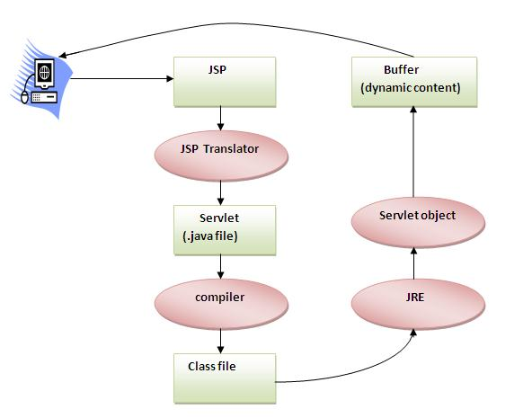
JSP

Slide 80
JSP
As depicted in the above diagram, JSP page is translated into servlet by the help of JSP translator. The JSP translator is a part of webserver that is responsible to translate the JSP page into servlet. Afterthat Servlet page is compiled by the compiler and gets converted into the class file. Moreover, all the processes that happens in servlet is performed on JSP later like initialization, committing response to the browser and destroy.
The JSP API
The JSP API consists of two packages:
javax.servlet.jsp
javax.servlet.jsp.tagext
javax.servlet.jsp package
Interfaces
JspPage
HttpJspPage
Classes
JspWriter
PageContext
JspException

Slide 81
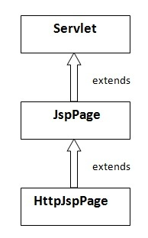
JSP
The JspPage interface
According to the JSP specification, all the generated servlet classes must implement the JspPage interface. It extends the Servlet interface. It provides two life cycle methods.

Slide 82
JSP
Methods of JspPage interface
public void jspInit(): It is invoked only once during the life cycle of the JSP when JSP page is requested firstly. It is used to perform initialization. It is same as the init() method of Servlet interface.
public void jspDestroy(): It is invoked only once during the life cycle of the JSP before the JSP page is destroyed. It can be used to perform some clean up operation.
The HttpJspPage interface
The HttpJspPage interface provides the one life cycle method of JSP. It extends the JspPage interface.
Method of HttpJspPage interface:
public void _jspService(): It is invoked each time when request for the JSP page comes to the container. It is used to process the request. The underscore _ signifies that you cannot override this method.

Slide 83
JSP
Scripting elements
The scripting elements provides the ability to insert java code inside the jsp. There are three types of scripting elements:
scriptlet tag
expression tag
declaration tag
JSP scriptlet tag
A scriptlet tag is used to execute java source code in JSP. Syntax is as follows:
<% java source code %>
JSP expression tag
The code placed within expression tag is written to the output stream of the response. So you need not write out.print() to write data. It is mainly used to print the values of variable or method.
Syntax of JSP expression tag
<%= statement %>
Do not end your statement with semicolon in case of expression tag.

Slide 84
JSP
JSP Declaration Tag
The JSP declaration tag is used to declare fields and methods.
The code written inside the jsp declaration tag is placed outside the service() method of auto generated servlet.
So it doesn't get memory at each request.
Syntax of JSP declaration tag
The syntax of the declaration tag is as follows:
<%! field or method declaration %>
Difference between the jsp scriptlet tag and jsp declaration tag ?
Jsp Scriptlet Tag | Jsp Declaration Tag
The jsp scriptlet tag can only declare variables not methods. | The jsp declaration tag can declare variables as well as methods.
The declaration of scriptlet tag is placed inside the _jspService() method. | The declaration of jsp declaration tag is placed outside the _jspService() method.

Slide 85
JSP
JSP Implicit Objects
There are 9 jsp implicit objects. These objects arecreated by the web container that are available to all the jsp pages.
The available implicit objects are out, request, config, session, application etc.
A list of the 9 implicit objects is given below:
Object | Type
out | JspWriter
request | HttpServletRequest
response | HttpServletResponse
config | ServletConfig
application | ServletContext
session | HttpSession
pageContext | PageContext
page | Object
exception | Throwable

Slide 86
JSP
JSP out implicit object
For writing any data to the buffer, JSP provides an implicit object named out. It is the object of JspWriter. In case of servlet you need to write:
PrintWriter out=response.getWriter();
But in JSP, you don't need to write this code.
JSP request implicit object
In JSP, request is an implicit object of type HttpServletRequest. It is created for each jsp request by the web container. It can be used to get request information such as parameter, header information etc.
JSP response implicit object
In JSP, response is an implicit object of type HttpServletResponse. The instance of HttpServletResponse is created by the web container for each jsp request.
It can be used to add or manipulate response such as redirect response to another resource, send error etc.

Slide 87
JSP
JSP config implicit object
In JSP, config is an implicit object of type ServletConfig. This object can be used to get initialization parameter for a particular JSP page. The config object is created by the web container for each jsp page.
Generally, it is used to get initialization parameter from the web.xml file.
JSP application implicit object
In JSP, application is an implicit object of type ServletContext.
The instance of ServletContext is created only once by the web container when application or project is deployed on the server.
This object can be used to get initialization parameter from configuaration file (web.xml). It can also be used to get, set or remove attribute from the application scope.
This initialization parameter can be used by all jsp pages.

Slide 88
JSP
session implicit object
In JSP, session is an implicit object of type HttpSession.The Java developer can use this object to set,get or remove attribute or to get session information.
pageContext implicit object
In JSP, pageContext is an implicit object of type PageContext class.The pageContext object can be used to set,get or remove attribute from one of the following scopes:
page
request
session
application
In JSP, page scope is the default scope.

Slide 89
JSP
exception implicit object
In JSP, exception is an implicit object of type java.lang.Throwable class. This object can be used to print the exception. But it can only be used in error pages.
JSP directives
The jsp directives are messages that tells the web container how to translate a JSP page into the corresponding servlet.
There are three types of directives:
page directive
include directive
taglib directive
Syntax of JSP Directive
<%@ directive attribute="value" %>

Slide 90
JSP
JSP page directive
The page directive defines attributes that apply to an entire JSP page.
Syntax of JSP page directive
<%@ page attribute="value" %>
import
The import attribute is used to import class,interface or all the members of a package.It is similar to import keyword in java class or interface.
contentType
The contentType attribute defines the MIME(Multipurpose Internet Mail Extension) type of the HTTP response.The default value is "text/html;charset=ISO-8859-1".
extends
The extends attribute defines the parent class that will be inherited by the generated servlet.It is rarely used.
info
This attribute simply sets the information of the JSP page which is retrieved later by using getServletInfo() method of Servlet interface.

Slide 91
JSP
buffer
The buffer attribute sets the buffer size in kilobytes to handle output generated by the JSP page.The default size of the buffer is 8Kb.
language
The language attribute specifies the scripting language used in the JSP page. The default value is "java".
isELIgnored
can ignore the Expression Language (EL) in jsp by the isELIgnored attribute. By default its value is false i.e. Expression Language is enabled by default.
isThreadSafe
Servlet and JSP both are multithreaded.If you want to control this behaviour of JSP page, you can use isThreadSafe attribute of page directive.The value of isThreadSafe value is true.If you make it false, the web container will serialize the multiple requests, i.e. it will wait until the JSP finishes responding to a request before passing another request to it.If you make the value of isThreadSafe attribute like:<%@ page isThreadSafe="false" %>

Slide 92
JSP
errorPage
The errorPage attribute is used to define the error page, if exception occurs in the current page, it will be redirected to the error page.
isErrorPage
The isErrorPage attribute is used to declare that the current page is the error page.
Jsp Include Directive
The include directive is used to include the contents of any resource it may be jsp file, html file or text file. The include directive includes the original content of the included resource at page translation time (the jsp page is translated only once so it will be better to include static resource).
Advantage of Include directive
Code Reusability
Syntax of include directive
<%@ include file="resourceName" %>

Slide 93
JSP
JSP Taglib directive
The JSP taglib directive is used to define a tag library that defines many tags. We use the TLD (Tag Library Descriptor) file to define the tags. In the custom tag section we use this tag.
Syntax JSP Taglib directive
<%@ taglib uri="uriofthetaglibrary" prefix="prefixoftaglibrary" %>
Exception Handling in JSP
The exception is normally an object that is thrown at runtime. Exception Handling is the process to handle the runtime errors. There may occur exception any time in your web application. So handling exceptions is a safer side for the web developer. In JSP, there are two ways to perform exception handling:
By errorPage and isErrorPage attributes of page directive
By <error-page> element in web.xml file

Slide 94
JSP
JSP Action Tags (Action Elements)
Each tag is used to perform some specific tasks. The action tags basically are used to control the flow between pages and to use Java Bean. Jsp action tags are as follows:
jsp:forward
jsp:include
jsp:useBean
jsp:setProperty
jsp:getProperty
jsp:forward action tag
The jsp:forward action tag is used to forward the request to another resource it may be jsp, html or another resource.
Syntax of jsp:forward action tag without parameter
<jsp:forward page="relativeURL | <%= expression %>" />
Syntax of jsp:forward action tag with parameter
<jsp:forward page="relativeURL | <%= expression %>">
<jsp:param name="parametername" value="parametervalue | <%=expression%>" />
</jsp:forward>

Slide 95
JSP
jsp:include action tag
The jsp:include action tag is used to include the content of another resource it may be jsp, html or servlet.
The jsp include action tag includes the resource at request time so it is better for dynamic pagesbecause there might be changes in future.
Syntax of jsp:include action tag without parameter
<jsp:include page="relativeURL | <%= expression %>" />
Syntax of jsp:include action tag with parameter
<jsp:include page="relativeURL | <%= expression %>">
<jsp:param name="parametername" value="parametervalue | <%=expression%>" />
</jsp:include>

Slide 96
JSP
Java Bean
A Java Bean is a java class that should follow following conventions:
It should have a no-arg constructor.
It should be Serializable.
It should provide methods to set and get the values of the properties, known as getter and setter methods.
Why use Java Bean?
A bean encapsulates many objects into one object, so we can access this object from multiple places.
jsp:useBean action tag
The jsp:useBean action tag is used to locate or instantiate a bean class. If bean object of the Bean class is already created, it doesn't create the bean depending on the scope. But if object of bean is not created, it instantiates the bean.

Slide 97
JSP
Syntax of jsp:useBean action tag
<jsp:useBean id= "instanceName" scope= "page | request | session | application
class= "packageName.className" type= "packageName.className"
beanName="packageName.className | <%= expression >" >
</jsp:useBean>
Attributes and Usage of jsp:useBean action tag
id: is used to identify the bean in the specified scope.
scope: represents the scope of the bean. It may be page, request, session or application. The default scope is page.
page: specifies that you can use this bean within the JSP page. The default scope is page.
request: specifies that you can use this bean from any JSP page that processes the same request. It has wider scope than page.
session: specifies that you can use this bean from any JSP page in the same session whether processes the same request or not. It has wider scope than request.

Slide 98
JSP
application: specifies that you can use this bean from any JSP page in the same application. It has wider scope than session.
class: instantiates the specified bean class (i.e. creates an object of the bean class) but it must have no-arg or no constructor and must not be abstract.
type: provides the bean a data type if the bean already exists in the scope. It is mainly used with class or beanName attribute. If you use it without class or beanName, no bean is instantiated.
beanName: instantiates the bean using the java.beans.Beans.instantiate() method.
jsp:setProperty and jsp:getProperty action tags
The setProperty and getProperty action tags are used for developing web application with Java Bean. In web devlopment, bean class is mostly used because it is a reusable software component that represents data.
The jsp:setProperty action tag sets a property value or values in a bean using the setter method.

Slide 99
JSP
Syntax of jsp:setProperty action tag
<jsp:setProperty name="instanceOfBean" property= "*" |
property="propertyName" param="parameterName" |
property="propertyName" value="{ string | <%= expression %>}"
/>
Example of jsp:setProperty action tag if you have to set all the values of incoming request in the bean
<jsp:setProperty name="bean" property="*" />
Example of jsp:setProperty action tag if you have to set value of the incoming specific property
<jsp:setProperty name="bean" property="username" />
Example of jsp:setProperty action tag if you have to set a specific value in the property
<jsp:setProperty name="bean" property="username" value=“satya" />

Slide 100
JSP
jsp:getProperty action tag
The jsp:getProperty action tag returns the value of the property.
Syntax of jsp:getProperty action tag
<jsp:getProperty name="instanceOfBean" property="propertyName" />
Expression Language (EL) in JSP
The Expression Language (EL) simplifies the accessibility of data stored in the Java Bean component, and other objects like request, session, application etc.
Syntax for Expression Language (EL)
${ expression }
Implicit Objects in Expression Language (EL)

Slide 101
JSP
Implicit Objects | Usage
pageScope | it maps the given attribute name with the value set in the page scope
requestScope | it maps the given attribute name with the value set in the request scope
sessionScope | it maps the given attribute name with the value set in the session scope
applicationScope | it maps the given attribute name with the value set in the application scope
param | it maps the request parameter to the single value
paramValues | it maps the request parameter to an array of values
header | it maps the request header name to the single value
headerValues | it maps the request header name to an array of values
cookie | it maps the given cookie name to the cookie value
initParam | it maps the initialization parameter
pageContext | it provides access to many objects request, session etc.

Slide 102
JSP
MVC in JSP
MVC stands for Model View and Controller. It is adesign pattern that separates the business logic, presentation logic and data.
Controller acts as an interface between View and Model. Controller intercepts all the incoming requests.
Model represents the state of the application i.e. data. It can also have business logic.
View represents the presentaion i.e. UI(User Interface).
Advantage of MVC (Model 2) Architecture
Navigation Control is centralized
Easy to maintain the large application

Slide 103
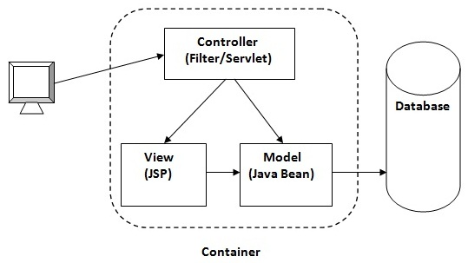
JSP
JSTL (JSP Standard Tag Library)
The JSP Standard Tag Library (JSTL) represents a set of tags to simplify the JSP development.
Advantage of JSTL
Fast Developement JSTL provides many tags that simplifies the JSP.
Code Reusability We can use the JSTL tags in various pages.
No need to use scriptlet tag It avoids the use of scriptlet tag.

Slide 104
JSP
JSTL mainly provides 5 types of tags:
Tag Name | Description
core tags | The JSTL core tag provide variable support, URL management, flow control etc. The url for the core tag is http://java.sun.com/jsp/jstl/core . The prefix of core tag is c.
sql tags | The JSTL sql tags provide SQL support. The url for the sql tags ishttp://java.sun.com/jsp/jstl/sql and prefix is sql.
xml tags | The xml sql tags provide flow control, transformation etc. The url for the xml tags is http://java.sun.com/jsp/jstl/xml and prefix is x.
internationalization tags | The internationalization tags provide support for message formatting, number and date formatting etc. The url for the internationalization tags ishttp://java.sun.com/jsp/jstl/fmt and prefix is fmt.
functions tags | The functions tags provide support for string manipulation and string length. The url for the functions tags is http://java.sun.com/jsp/jstl/functions and prefix is fn.

Slide 105
JSP
Custom Tags in JSP
Custom tags are user-defined tags. They eliminates the possibility of scriptlet tag and separates the business logic from the JSP page.
The same business logic can be used many times by the use of costom tag.
Advantages of Custom Tags
The key advantages of Custom tags are as follows:
Eliminates the need of srciptlet tag The custom tags eliminates the need of scriptlet tag which is considered bad programming approach in JSP.
Separation of business logic from JSP The custom tags separate the the business logic from the JSP page so that it may be easy to maintain.
Reusability The custom tags makes the possibility to reuse the same business logic again and again

Slide 106
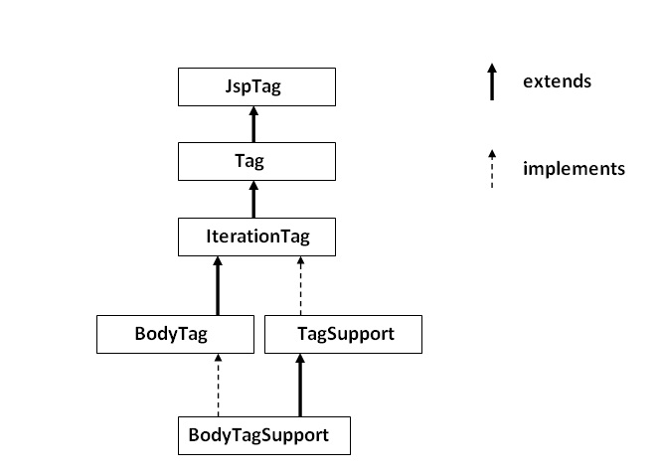
JSP
JSP Custom Tag API
The javax.servlet.jsp.tagext package contains classes and interfaces for JSP custom tag API. The JspTag is the root interface in the Custom Tag hierarchy.

Slide 107
JSP
JspTag interface
The JspTag is the root interface for all the interfaces and classes used in custom tag. It is a marker interface.
Tag interface
The Tag interface is the sub interface of JspTag interface. It provides methods to perform action at the start and end of the tag.
Fields of Tag interface
Field Name | Description
public static int EVAL_BODY_INCLUDE | it evaluates the body content.
public static int EVAL_PAGE | it evaluates the JSP page content after the custom tag.
public static int SKIP_BODY | it skips the body content of the tag.
public static int SKIP_PAGE | it skips the JSP page content after the custom tag.

Slide 108
JSP
Method Name | Description
public void setPageContext(PageContext pc) | it sets the given PageContext object.
public void setParent(Tag t) | it sets the parent of the tag handler.
public Tag getParent() | it returns the parent tag handler object.
public int doStartTag()throws JspException | it is invoked by the JSP page implementation object. The JSP programmer should override this method and define the business logic to be performed at the start of the tag.
public int doEndTag()throws JspException | it is invoked by the JSP page implementation object. The JSP programmer should override this method and define the business logic to be performed at the end of the tag.
public void release() | it is invoked by the JSP page implementation object to release the state.

Slide 109
JSP
IterationTag interface
The IterationTag interface is the sub interface of the Tag interface. It provides an additional method to reevaluate the body.
Field of IterationTag interface
There is only one field defined in the IterationTag interface.
public static int EVAL_BODY_AGAIN it reevaluates the body content.
Method of Tag interface
There is only one method defined in the IterationTag interface.
public int doAfterBody()throws JspException it is invoked by the JSP page implementation object after the evaluation of the body. If this method returns EVAL_BODY_INCLUDE, body content will be reevaluated, if it returns SKIP_BODY, no more body cotent will be evaluated.

Slide 110
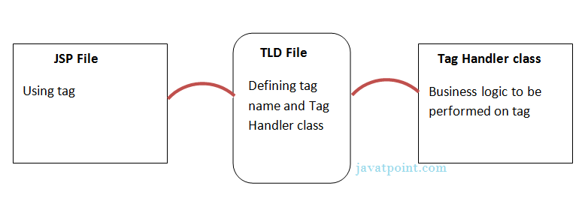
JSP
TagSupport class
The TagSupport class implements the IterationTag interface. It acts as the base class for new Tag Handlers.
For creating any custom tag, we need to follow following steps:
Create the Tag handler class and perform action at the start or at the end of the tag.
Create the Tag Library Descriptor (TLD) file and define tags
Create the JSP file that uses the Custom tag defined in the TLD file
Understanding flow of custom tag in jsp

Slide 111
JSP
Attributes in JSP Custom Tag
There can be defined too many attributes for any custom tag. To define the attribute, you need to perform two tasks:
Define the property in the TagHandler class with the attribute name and define the setter method
define the attribute element inside the tag element in the TLD file
Custom URI in JSP Custom Tag
We can use the custom URI, to tell the web container about the tld file. In such case, we need to define the taglib element in the web.xml. The web container gets the information about the tld file from the web.xml file for the specified URI.

